Slide 1

ECE 802, Electric Motor Control Switched Reluctance Motors

Slide 2
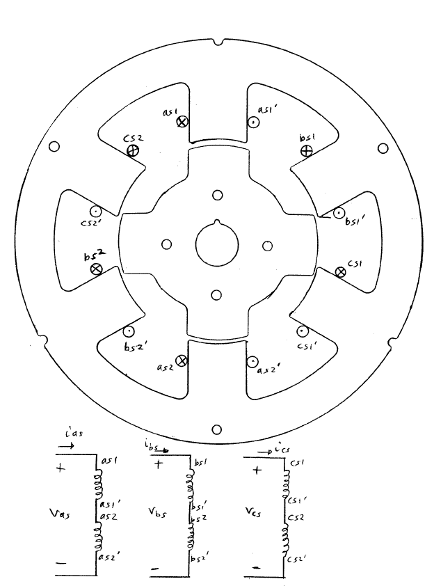
Switched Reluctance Motors (SRMs)
The SRM is similar to a single-stack reluctance stepper motor
RT = 4
N = 3
SL = 30º
However, the SRM is operated at continuous speed
Typical 6/4 SRM shown here

Slide 3
Per-Phase Analysis

Slide 4
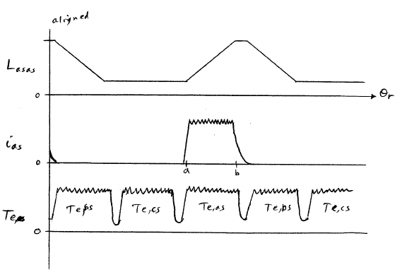
Waveforms
Because of torque pulsations, more phases are preferred

Slide 5
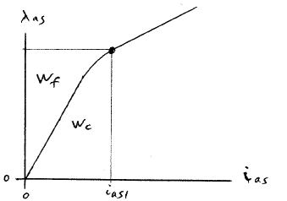
Energy Analysis
W_{f} - field energy
W_{c} - co-energy
For a linear system,

Slide 6
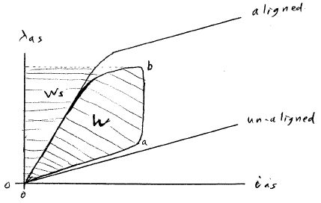
Flux Linkage Path
W - converted energy
W_{s} - stored energy

Slide 7
Electrical Equations (a-phase)

Slide 8
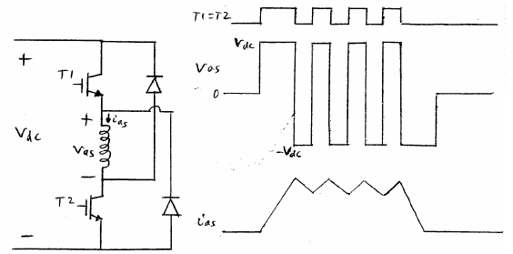
SRM Inverter
Based on the H-bridge inverter topology
Typically used to shape current, but can also be stepped at low frequency

Slide 9
Inverter with One Switch per Phase
Only requires one switch
However, off state is
instead of

Slide 10
SR Motors
Advantages
Low manufacturing cost (no magnets or aluminum on the rotor)
Low rotor losses (compared to IM)
Fault tolerant (fault in one phase can be isolated)
Shoot-through protection
Phases operate almost independently
Disadvantages
Position sensor required
Higher torque ripple/noise
Higher windage losses
Can not operate from a three-phase line
Six (or more) motor leads required
Cant effectively use standard dual IGBT modules

